Slide 1


GeoTIFF READER
Presented by:
Harsha.N.Kalyani
VII SEM COMPUTUTER TECHNOLOGY
Guided By
Prof.P.Singham
Co-guided By
Prof.Y.Golhar

Slide 2
questions
Slide no.5-tiff 2nd point
Slide no.10-control points
-custom prog writing
Slide no 14-geotiff file structure
Slide no.15-diagram
Slide no 16-proposed modules
Conclusion?

Slide 3
Aim
To design a GeoTIFF reader which would describe the cartographic information that originates from satellite imaging system.

Slide 4
Order of Presentation
I. TIFF Overview
II. GeoTIFF Overview
III. Conclusion

Slide 5
I. TIFF Overview

Slide 6
What is TIFF?
TIFF (Tagged Image File Format), is format for storing raster images data.
TIFF is a rich format for raster image data from sources such as:
  remotely sensed imagery
  scanners
  painting,drawing, and rendering output from CAD
  Results of geographic analysis.

Slide 7
TIFF Features
Portable
Extensible
Supports Tiling and Compression
Multiple Color models
  greyscale
  bilevel
  true color
  palette color
Already used by many Geographic systems and stable for many years.

Slide 8
TIFF Reader Structure
The TIFF format has a three-level hierarchy. From highest to lowest, the levels are:
1) A file Header.
2) One or more directories called IFDs (Image File Directories), containing codes and their data, or pointer to the data.
3) Data.

Slide 9
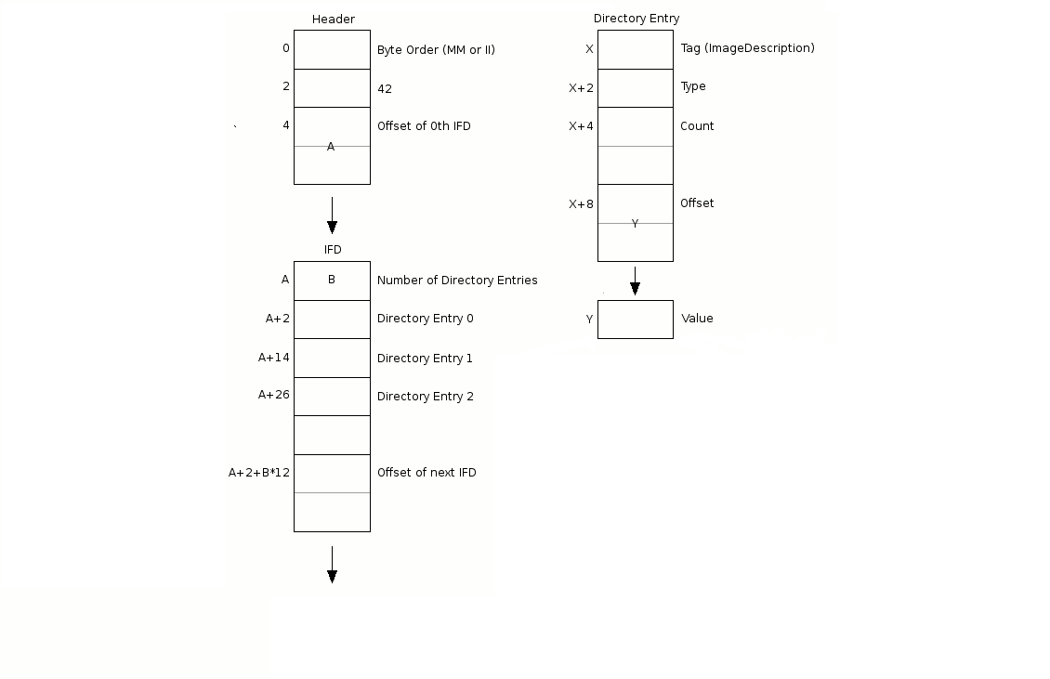
Graphical view of TIFF reader

Slide 10
II. GeoTIFF-Overview

Slide 11
Limitation of Non-Geographic TIFF Imagery
No support for Georeferencing Information.
Requires user effort to get the image in correct position in the GIS Display or plot
  Specifying Control Points
  Co-ordinate strings/vender specific geodetic codes
  Custom program writing

Slide 12
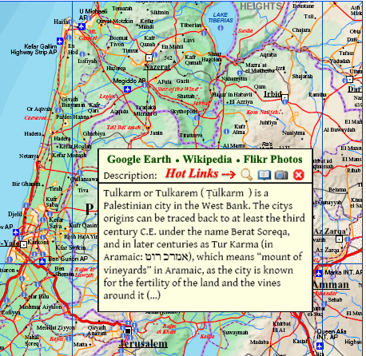
TIFF File
Containing
Geographical
Information.

Slide 13
GeoTIFF-A Standard Image File Format for GIS Applications

Slide 14
Features of GeoTIFF
GeoTIFF fully complies with the TIFF 6.0 specifications.
GeoTIFF uses a small set of reserved TIFF tags .
GeoTIFF uses a "MetaTag" (GeoKey) approach .

Slide 15
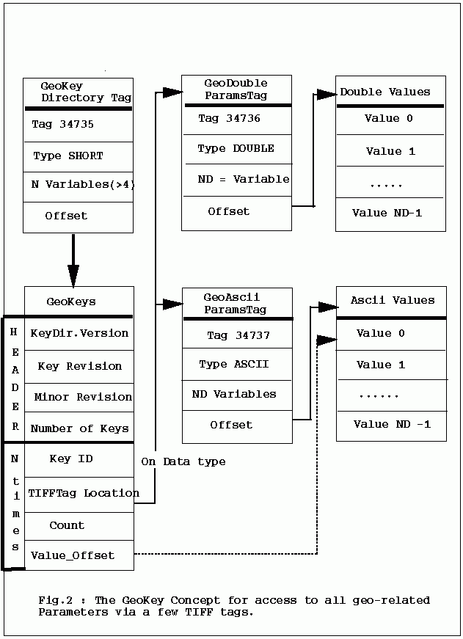
GeoTIFF Reader Structure

Slide 16
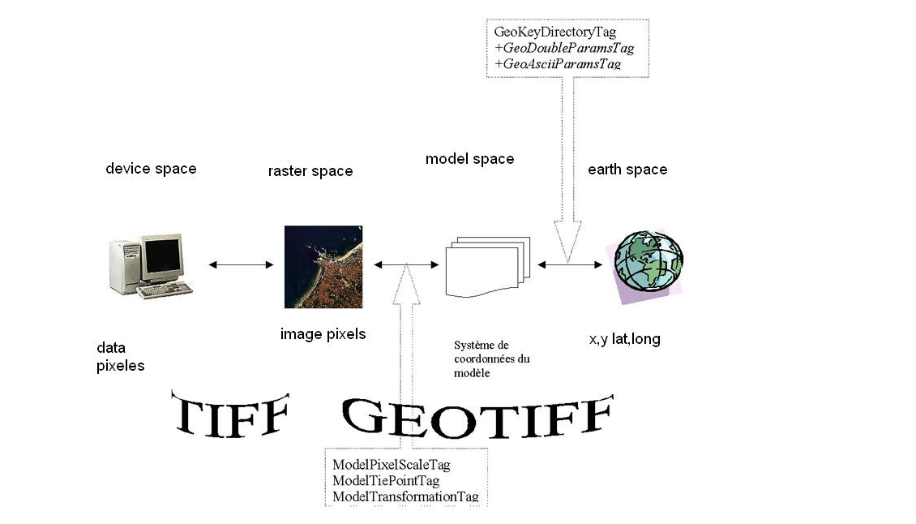

Slide 17
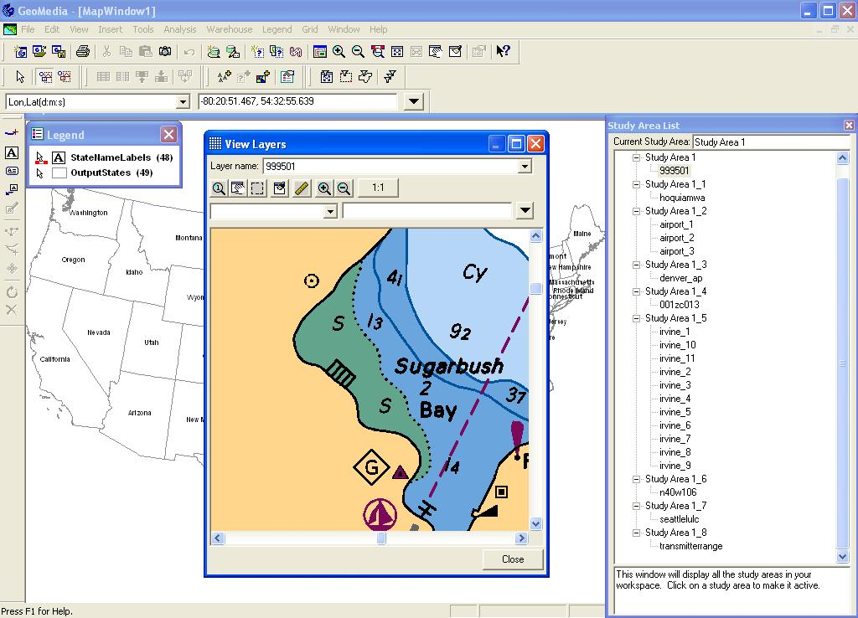

Slide 18
References
  http://www.remotesensing.org/geotiff.
  http://www.geotiff.org/: Niles Ritters GeoTIFF Site (home of Java GeoTIFF packages, and GeoTIFF 2.0 Specification Development).
  ftp://ftpmcmc.cr.usgs.gov/release/geotiff/images/: Various sample GeoTIFF files.
  GeoTIFF FAQ written by Mike Ruth.

Slide 19
Thank You

